Slide 1

Building a Fitness Analytics Dashboard
Transforming raw fitness data into actionable insights for personalized health.

Slide 2
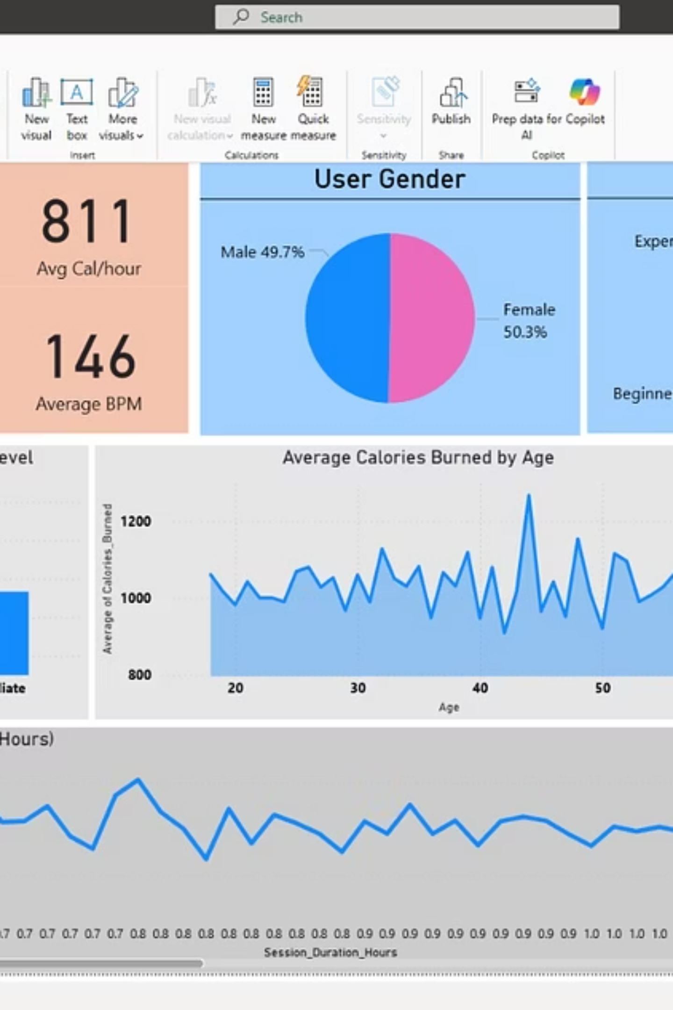
The Foundation: Understanding Our Data
Our journey begins with raw fitness data, encompassing various metrics crucial for comprehensive analysis. Each data point tells a story about an individual's fitness journey.
1
2
User Demographics
Workout Metrics
Age, Gender, Weight, Height, BMI, Fat Percentage, Experience Level, Workout Frequency.
Max BPM, Avg BPM, Resting BPM, Session Duration, Calories Burned, Workout Type.
3
Hydration & Habits
Water Intake (liters).

Slide 3
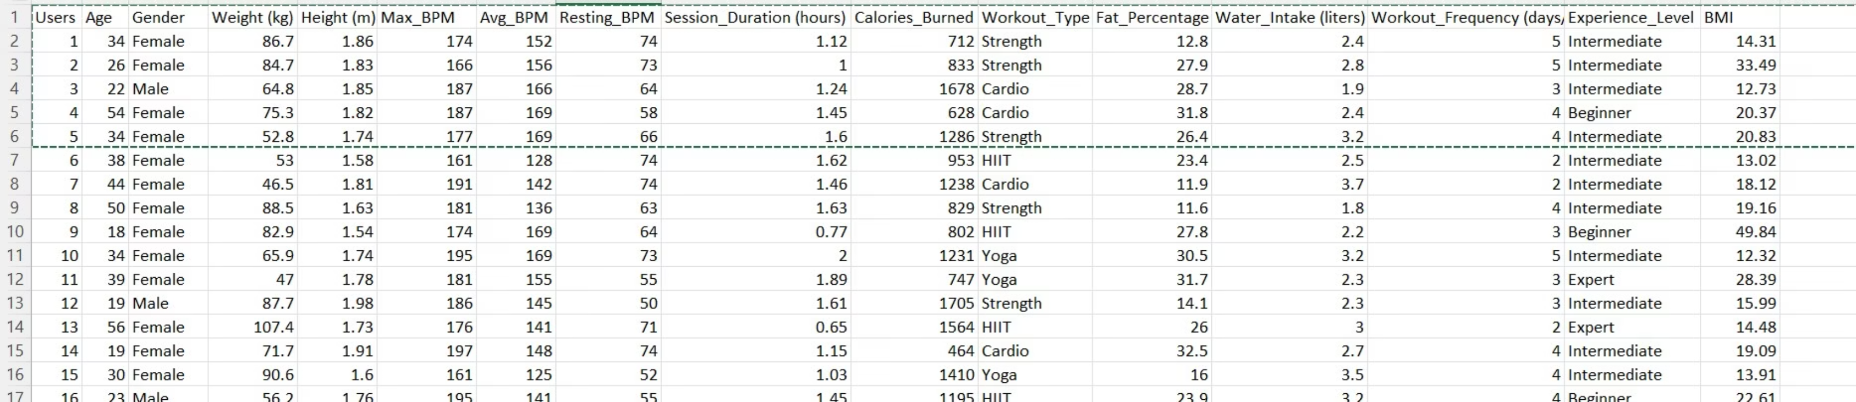
Initial Data Snapshot
Here's a glimpse into the diverse data collected from our users, illustrating the variety in fitness profiles and workout habits. This raw data is the starting point for our analysis.
This sample highlights the diverse user base, ranging from different ages and genders to varied workout types and fitness levels. This richness in data allows for granular analysis of fitness trends and individual performance.

Slide 4

Database Design: Creating a Star Schema
To efficiently analyze our fitness data, we've implemented a star schema database design. This approach separates data into fact and dimension tables, optimizing for query performance and analytical flexibility.
DimUser
User attributes and profile data
FactWorkout
DimWorkoutType
Measures of workouts for analysis
Categories and metadata for workouts
DimDate (optional)
Date hierarchy and time attributes
The FactWorkout table contains quantitative data about each workout session, while dimension tables like DimUser and DimWorkoutType provide descriptive attributes. This structure simplifies complex queries and enhances data integrity.

Slide 5
Building Our Dimensions: Detailed User & Workout Type Tables
Dimension tables are critical for providing context to our numerical facts. We've created DimUser to store comprehensive user information and DimWorkoutType for categorizing workout activities.
DimUser Table
DimWorkoutType Table
CREATE TABLE DimUser ( User_ID INT PRIMARY KEY, Age INT, Gender VARCHAR(10), Weight_kg DECIMAL(5,2), Height_m DECIMAL(4,2), BMI DECIMAL(5,2), Fat_Percentage DECIMAL(5,2), Workout_Frequency_days_week INT, Experience_Level VARCHAR(20));
CREATE TABLE DimWorkoutType ( Workout_Type_ID INT AUTO_INCREMENT PRIMARY KEY, Workout_Type VARCHAR(50));
These tables are populated with distinct values from the raw data, ensuring each user and workout type has a unique, consistent identifier for analysis.

Slide 6
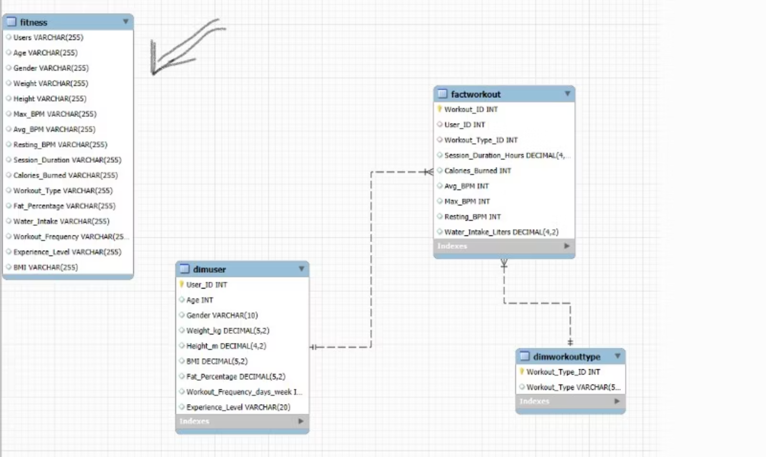

Slide 7
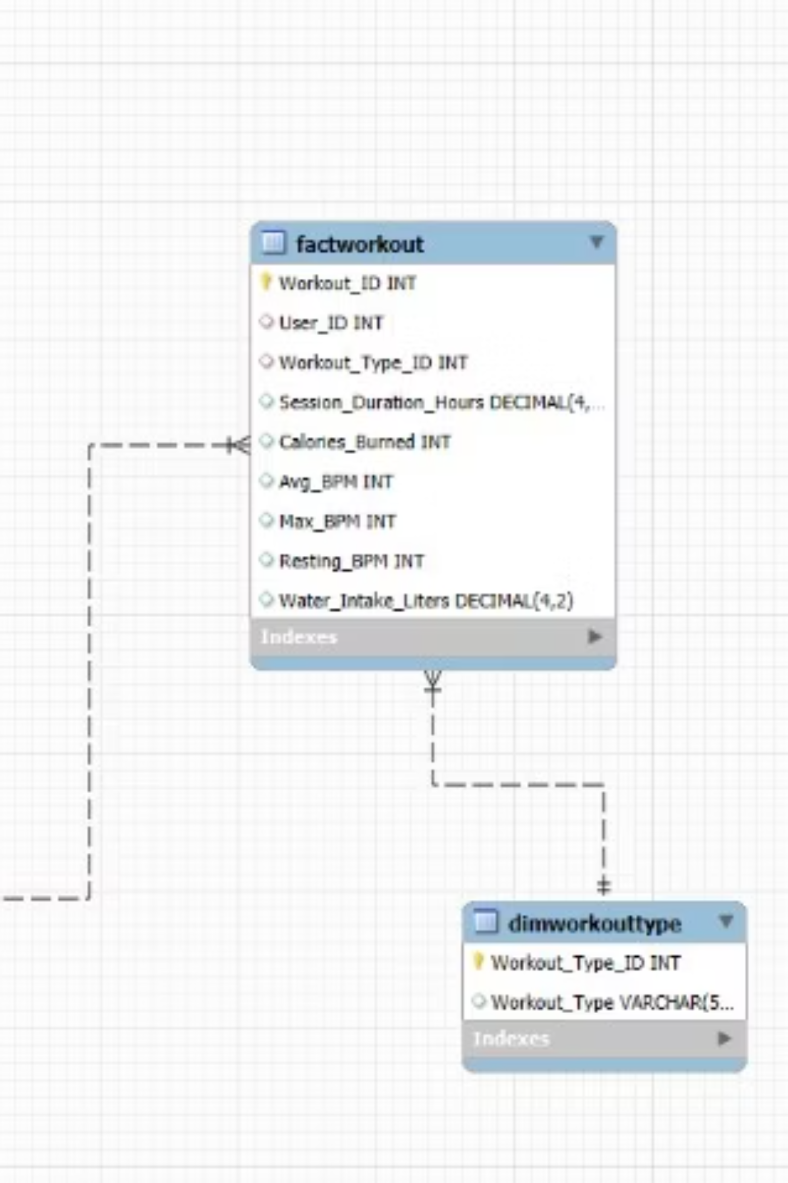
The Core: FactWorkout Table
The FactWorkout table is the heart of our analytical database, linking users to their specific workout sessions and key performance indicators. It allows us to track session duration, calories burned, heart rate, and water intake.
CREATE TABLE FactWorkout ( Workout_ID INT AUTO_INCREMENT PRIMARY KEY, User_ID INT, Workout_Type_ID INT, Session_Duration_Hours DECIMAL(4,2), Calories_Burned INT, Avg_BPM INT, Max_BPM INT, Resting_BPM INT, Water_Intake_Liters DECIMAL(4,2), FOREIGN KEY (User_ID) REFERENCES DimUser(User_ID), FOREIGN KEY (Workout_Type_ID) REFERENCES DimWorkoutType(Workout_Type_ID));
This fact table aggregates the measurable events, providing the foundation for calculating performance metrics and trends over time.

Slide 8


Data Cleaning & Preprocessing
Before analysis, data must be clean and consistent. We address common issues like unexpected characters or leading/trailing spaces in critical numerical fields to ensure data integrity.
Identify Inconsistencies
Trim & Replace
Validate & Update
Locating non-numeric characters in fields meant for numbers (e.g., Max_BPM).
Removing hidden characters like tabs or newlines that can disrupt data parsing.
Ensuring all numerical fields contain only digits, making them suitable for calculations.
Clean data is paramount for accurate reporting and reliable insights. These steps prevent errors in calculations and ensure our analytical views are trustworthy.

Slide 9
Key Analytical Views: Unlocking Insights
We've created several SQL views to provide aggregated insights into user demographics, workout performance, and activity correlations, making complex data readily accessible.
vw_gender_percentage
Shows the distribution and percentage of male and female users in the database.
vw_user_age_stats
Calculates the minimum, maximum, and average age of users.
vw_experience_percentage
Details the percentage of users at each experience level (Beginner, Intermediate, Expert).
vw_workout_summary
Provides average calories burned and session duration across all workouts.
vw_workouttype_summary
Summarizes the count and percentage of each workout type performed.
vw_activity_correlation
Correlates user attributes (age, gender, experience) with session duration and calories burned, including calories per hour.
vw_experience_performance
Compares performance metrics (sessions, calories, heart rate, water intake) across different experience levels.

Slide 10
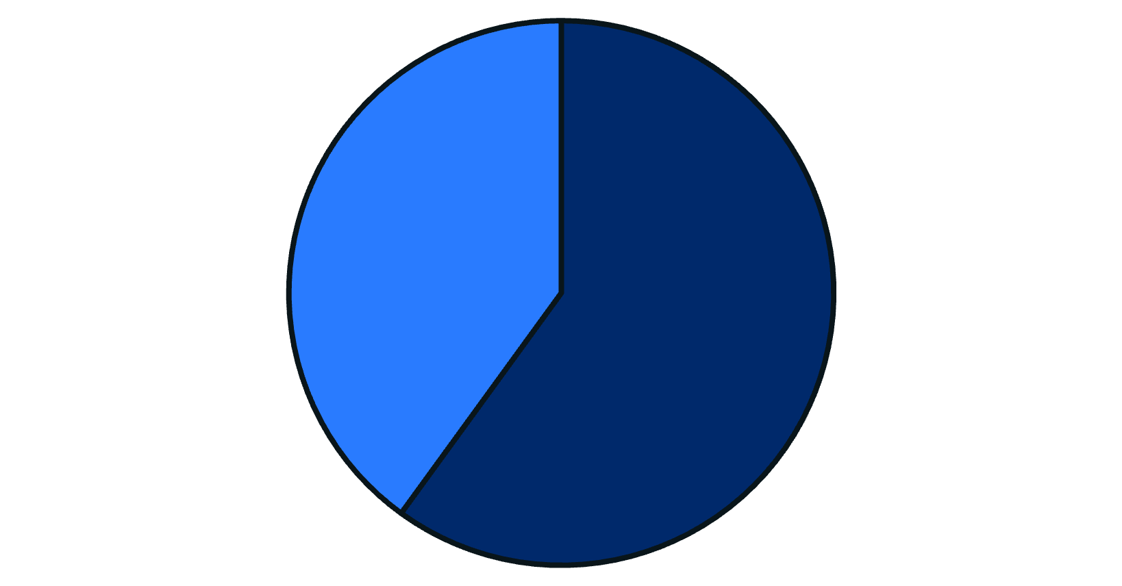
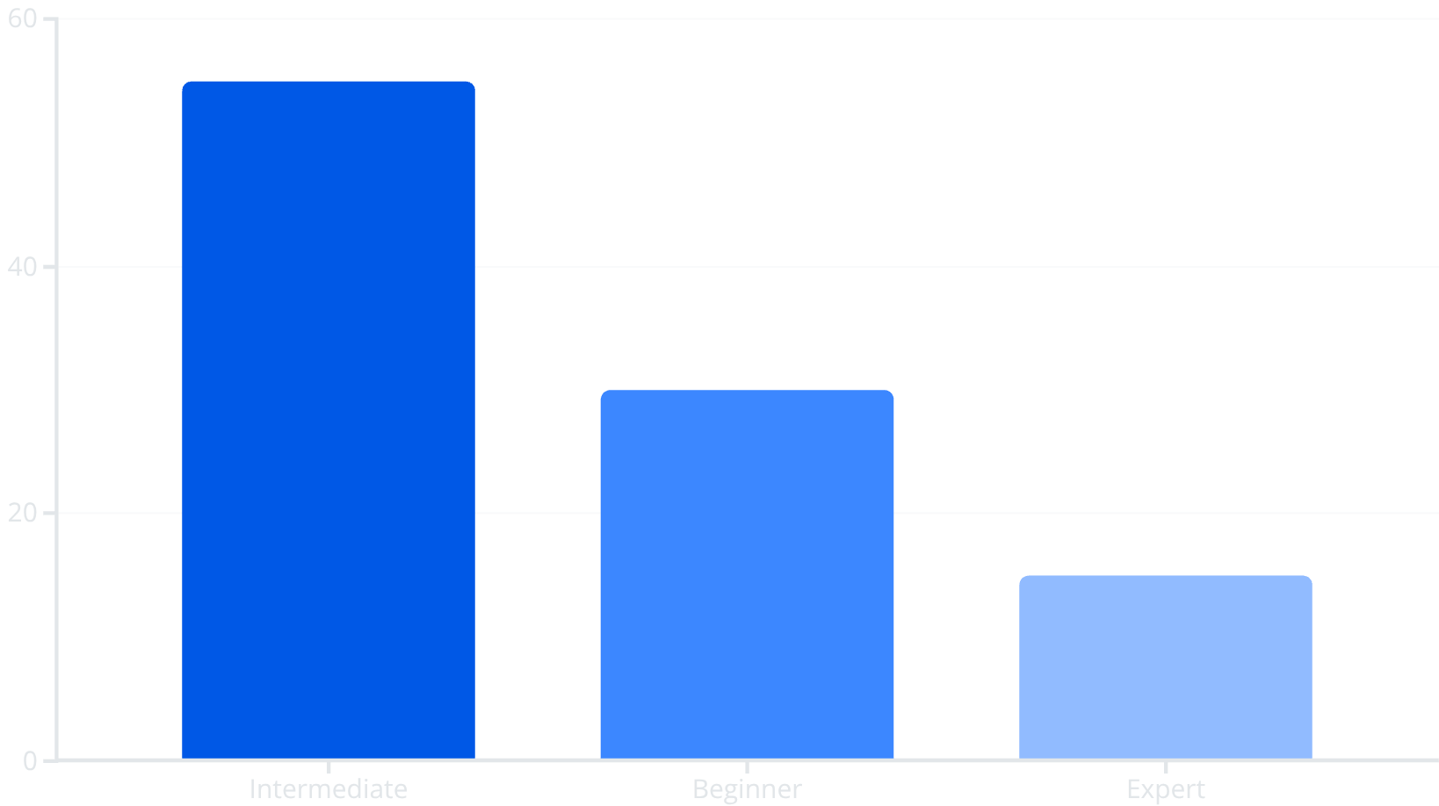
User Demographic Insights
Understanding our user base is crucial. These views provide a clear picture of user age distribution, gender balance, and experience levels, enabling targeted fitness program development.
Gender Distribution
Experience Levels
Female
Male
The data reveals a slightly higher representation of female users and a strong presence of intermediate-level fitness enthusiasts. This informs how we can tailor our offerings.

Slide 11
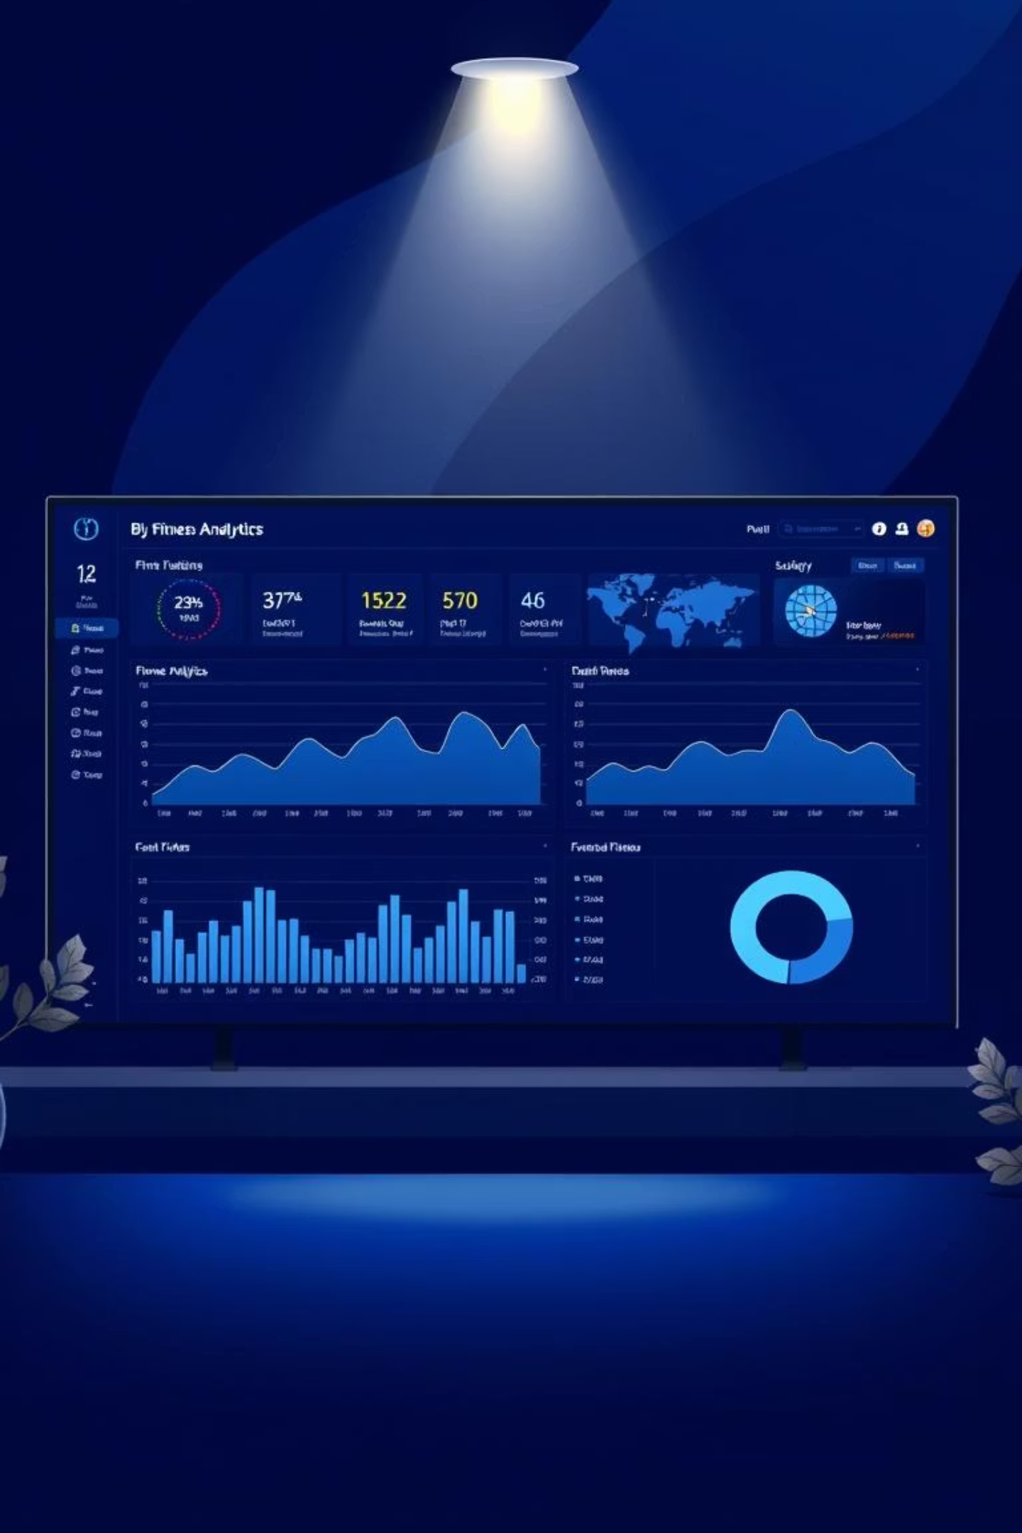

Visualizing Insights with Power BI
The culmination of our database design and data cleaning is the creation of interactive dashboards in Power BI. These dashboards transform complex SQL views into intuitive visualizations, providing actionable insights at a glance.
Connecting the SQL schema directly to Power BI allows us to dynamically explore trends, compare user performance, and identify key areas for improvement in fitness routines. This empowers users and trainers with personalized data-driven guidance.
By leveraging a well-structured database and powerful visualization tools, we can move beyond raw data to truly understand and optimize fitness journeys.

